Slide 1
Robot Framework
Training Session 1

Slide 2
Libraries
Internal
Builtin, Collections, String, Operating System, etc…
External
Selenium2Library, SSHLibrary, requests, httplibrary, ftplibrary , pymysql, pyyaml, DatabaseLibrary, etc…
For more information on Libraries visit:
http://robotframework.org/#libraries

Slide 3
Installing New Library
Installing a new Robot Framework Library using PIP
Usage: pip.exe install <library name>
Example: pip.exe install PYYAML
Libraries available for download at https://pypi.python.org/simple/

Slide 4
Updating Existing Library
Updating a Robot Framework Library using PIP
Usage: pip.exe install --upgrade <library name>
Example: pip.exe install --upgrade PYYAML

Slide 5
Tags
Tags are a simple mechanism for classifying test cases.
Uses:
Tags are shown in test reports, logs and, of course, in the test data, so they provide metadata to test cases.
Statistics about test cases (total, passed, failed are automatically collected based on tags).
With tags, you can include or exclude test cases to be executed.
With tags, you can specify which test cases are considered critical.

Slide 6
Test Execution w/Tags
Execute only tests with the specified Tags
Usage: pybot -i <tag to include> <test suite>
Example 1: pybot -i Acceptance API.txt
Example 2: pybot –i Acceptance –i Regression API.txt
Execute tests WITHOUT the specified Tags
Usage: pybot -e <tag to exclude> <test suite>
Example 1: pybot -e Acceptance API.txt
Example 2: pybot -e Feature –e Regression API.txt
Mark a Tag as Critical
Usage: pybot -c <critical tag> <test suite>
Example: pybot -c Feature API.txt
*It is possible to combine –i and –e options in the same command. Excluded tests are not run even if included with –i.

Slide 7
Defining Tags
*** Settings ***
Documentation Script automating the ACTIVATION API Interface
Suite Setup Check VM is Ready ${VM_UNDER_TEST} ${flavorName} ${imageName} ${openstackName}
Suite Teardown Close AllResource ../API.robotResource ACTIVATION_SPRINT10.robot
Variables SPRINT.YAML
*** Variables ***
*** Test Cases ***
ACTIVATION_list_services
[Documentation] Check the ACTIVATION API interface for ACTIVATION_list_services
[Tags] Acceptance Feature
[Setup]
Run Single API Test ACTIVATION ACTIVATION_list_services ${VM_UNDER_TEST}
[Teardown]

Slide 8
Resource Files
Resource files
Are like user created libraries
Provide test scripts access to user defined keywords and variables
Help organize code

Slide 9
Resource Files Continued
Reusable Keywords should be stored in external resource files
Example: SSH.robot
*** Settings ***
Documentation Global variables and global procedures for opening SSH session
Library SSHLibrary
Library BuiltIn
*** Keywords ***
Open Connection And Log In
[Arguments] ${HOST} ${USERNAME} ${PASSWORD} ${PROMPT}
[Documentation] Open Connection And Log In
Set Default Configuration timeout=20 seconds prompt=${PROMPT}
${CONNECTION}= Open Connection ${HOST}
Login ${USERNAME} ${PASSWORD}
[Return] ${CONNECTION}
Close SSH
[Arguments] ${CONNECTION} # Connection to close
[Documentation] Closes SSH Connection
Switch Connection ${CONNECTION}
Log Closing Connection ${CONNECTION}
Close Connection
Close All
Close All Connections

Slide 10
Remote Systems (SSHLibrary)
SSH to remote server
${VTC}= Open Connection And Log In ${VTC_ip} ${VTC_user} ${VTC_password} $
Switch Connection ${VTC}
Running command and capture result
SSHLibrary.Write ./G8-CCF-7 32
${output}= Read Until Prompt
Validate Result
${status}= Run Keyword and Return Status Should Contain ${output} Test Case Passed

Slide 11
List Variable
Lists store groups of values
List values are accessed by index (starts with 0).
Creating a List
Lists can be defined directly:
${List}= Create List A B C D E
Lists can be derived from scalar variables using the Split String keyword
${String}= set variable A B C D E
${List}= Split String ${String} ${SPACE}
List= | A | B | C | D | E
Index | 0 | 1 | 2 | 3 | 4

Slide 12
Modifying List Variable
Adding item to List
Append to List ${List} F
Remove an item from List
Remove From List ${List} 2
Combining Lists
${List2}= Create List G H I J K
@{Combined}= Combine Lists ${List1} ${List2}
List= | A | B | C | D | E | F
Index | 0 | 1 | 2 | 3 | 4 | 5
List= | A | B | D | E | F
Index | 0 | 1 | 2 | 3 | 4
Combined= | A | B | D | E | F | G | H | I | J | K
Index | 0 | 1 | 2 | 3 | 4 | 5 | 6 | 7 | 8 | 9

Slide 13
Dictionary List Variable
Dictionaries provide way of accessing a list of information based on a ‘key’
***Variables***
&{MakeCallArgument} G8-CCF-7=32
${testid}= set variable G8-CCF-7
Usage Example:
SSHLibrary.Write ./${testid} &{MakeCallArgument}[${testid}]
Is interpreted as: ./G8-CCF-7 32

Slide 14
Variable Files
Variable Files store Global variables outside of test scripts.
2 of the most common are Robot Variable Files and YAML.
A Robot Resource File that only contains Variables may also be used to achieve the same result.
Variables.py | Variables.YAML
VARIABLE = "An example string" INTEGER = 42 LIST_OF_STRINGS = ["one", "two", “three", "four"] LIST = [1, STRING, 3.14] DICTIONARY = {"one": 1, "two": 2, "three": 3} | VARIABLE: An example string INTEGER: 42 LIST_OF_STRINGS: - one - two - three - four LIST : - 1 - STRING - 3.14 DICTIONARY: one: 1 two: 2 three: 3
Variables.robot
*** Variables *** ${VARIABLE} "An example string" ${INTEGER} 42 @{LIST_OF_STRINGS} one two three four @{LIST} 1 STRING 3.14 &{DICTIONARY} one=1 two=2 three=3

Slide 15
Flow Control
Robot Framework supports some level of Flow Control through the use of special keywords.
Examples:
Run Keyword If
  ${status}= Run Keyword and Return Status Should Contain ${output} Test Case Passed
  Run Keyword If ${status} Log ${testid} Successful!
  Run Keyword If ${status} == False Fail ${testid} FAILED!
Set Variable If
  ${Result}= Set Variable If ${status} Pass Fail
Other helpful Keywords:
  Run Keyword And Return If
  Run Keyword If All Critical Tests Passed
  Run Keyword If All Tests Passed
  Run Keyword If Any Critical Tests Failed
  Run Keyword If Any Tests Failed
  Run Keyword If Test Failed
  Run Keyword If Test Passed
  Run Keyword If Timeout Occurred

Slide 16
Looping
Looping using a Range of numbers
  ${Num}= set variable 10
  ${i}= set variable 0
  : FOR ${i} IN RANGE 0 ${Num}
  \ Log ${i}
Looping through a list
  @{list}= Split String ${line} ,
  : FOR ${item} IN @{list}
  \ Log ${item}
Loop Until condition is met
Wait Until keyword succeeds 600 seconds 1 seconds DoCall ${testid}

Slide 17
Nested Looping
Robot Framework does not support Nested Loops
The workaround is to call a user defined keyword from within a loop that contains another loop.
Example: ${Scalar}= Set Variable A B C D E F;G H I J K L @{List}= Split String ${Scalar} ; : FOR ${item} IN @{List} Log ${item} Nested ${item} User Defined Keyword: Nested [Arguments] ${item} [Documentation] Nested Loop @{list}= Split String ${item} ${SPACE} : FOR ${var} IN @{list} Log ${var} | Output A B C D E F A B C D E F G H I J K L G H I J K L

Slide 18
String Manipulation
Replace String
${string}= set variable Old Table
${string}= Replace String ${string} Old New
${string}= New Table
Joining Strings
${string2} = set variable Legs
${string}= set variable ${string} {$string2}
${string} = New Table Legs

Slide 19
Billing Test case
Test Name: G8-CCF-7
Steps:
Login to Automation server and make a call
Decode CDR Files on CCF server
Validate Information relating to call
  IMSRecord: aSRecord
  CallingPartyAddress: sip:+15613330020@ims.net
  CalledPartyAddress: sip:+19085822787@ims.net
  causeForRecordClosing: serviceDeliveryEndSuccessfully
  callDirection: origination

Slide 20
Settings
*** Settings ***
Documentation Billing Validation
Library String
Library BuiltIn
Library Collections
Library OperatingSystem
Resource SSH.robot

Slide 21
Global Variables
*** Variables ***
${CCF_ip} ***.***.***.***
${CCF_user} ******
${CCF_password} ******
${reportsTopDir} C:/temp/reports/VTC/Billing
${workspace} dev
${reportDir} ${EMPTY}
&{CallingParty} G8-CCF-7=15613330020
&{CalledParty} G8-CCF-7=19085822787
${cdrTemp} /tmp/Automation
${startTimeReports} ${EMPTY}
${testDir} ${EMPTY}
&{MONTHS} Jan=01 Feb=02 Mar=03 Apr=04 May=05 Jun=06 Jul=07 Aug=08 Sep=09 Oct=10 Nov=11 Dec=12
${ACRLogDir} /sn/log
&{MakeCallArgument} G8-CCF-7=32
${VTC_ip} ***.***.***.***
${VTC_user} ******
${VTC_password} ******
@{sessionDataFolders} CDR_DATA
@{CDRs}

Slide 22
Validation File
Validation.YAML
G8-CCF-7:
IMSRecord: aSRecord
CallingPartyAddress: sip:+15613330020@ims.net
CalledPartyAddress: sip:+19085822787@ims.net
causeForRecordClosing: serviceDeliveryEndSuccessfully
callDirection: origination

Slide 23
Test case Details
Login to CCF Server and check to see if it is running (psp-init.halt NOT present)
Create Test Case log folders in on local machine
Create Test Dir on CCF server
Make Call:
  For 20 minutes try the following until successful:
  Wait Before Making Call
  Get Information on the last pair of CDR files to be generated (ls -lrt | tail -2 | head -1)
  Calculate the amount of time to wait until making a call based on CDR timestamp
  Sleep the appropriate amount of time
  Start ACR Log on CCF server
  Make Call on VTC server
Decode:
  For 20 minutes try the following until successful:
  Wait Before Decode
  Get Information on the last pair of CDR files to be generated (ls -lrt | tail -2 | head -1)
  Calculate the amount of time to wait until a new set of CDR files will be generated based on CDR timestamp
  Sleep the appropriate amount of time
  Decode the CDR File
Validate CDR Contains:
  IMSRecord: aSRecord
  CallingPartyAddress: sip:+15613330020@ims.net
  CalledPartyAddress: sip:+19085822787@ims.net
  causeForRecordClosing: serviceDeliveryEndSuccessfully
  callDirection: origination

Slide 24
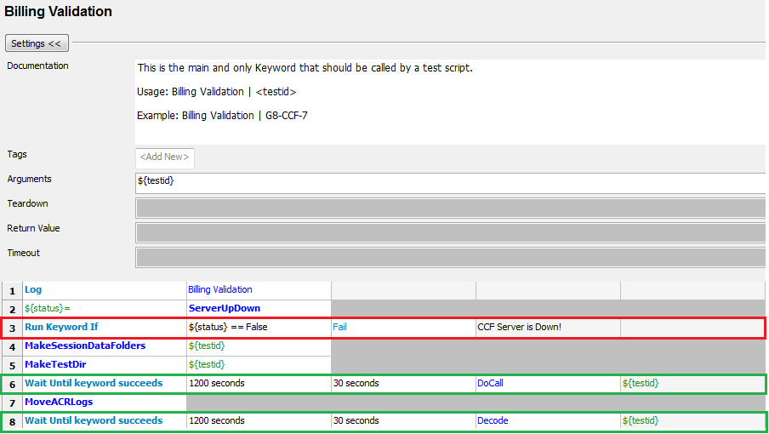
Billing Validation

Slide 25
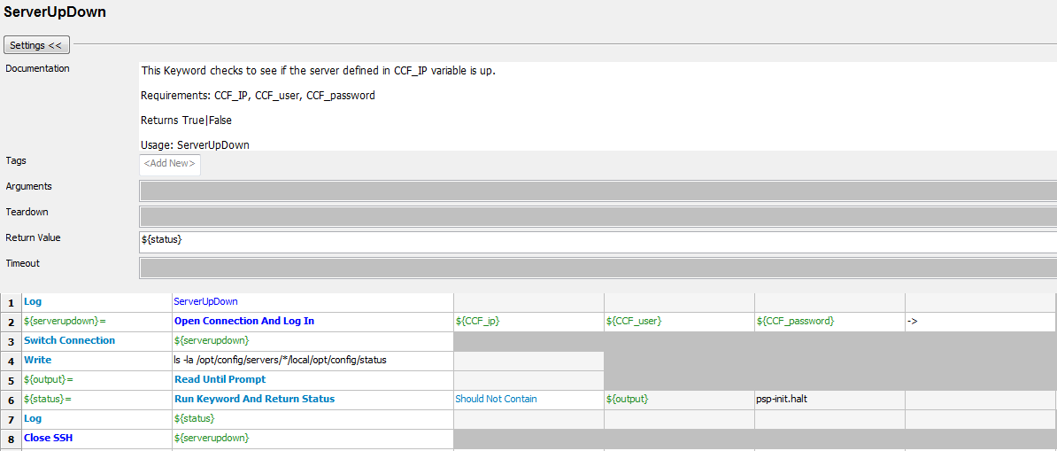
ServerUpDown

Slide 26
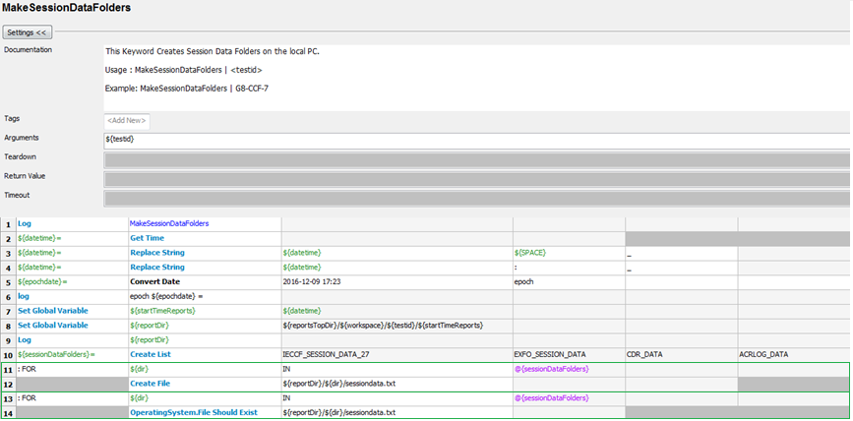
MakeSessionDataFolders

Slide 27
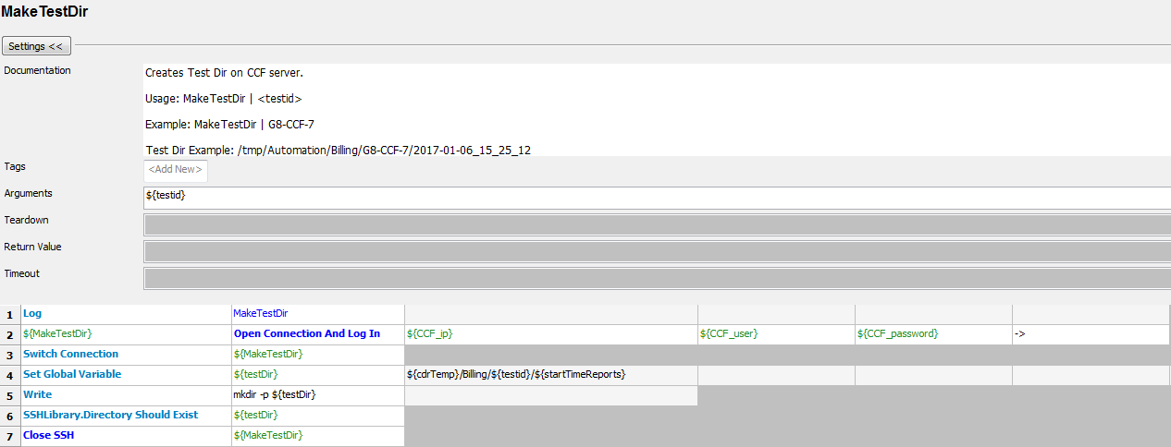
MakeTestDir

Slide 28
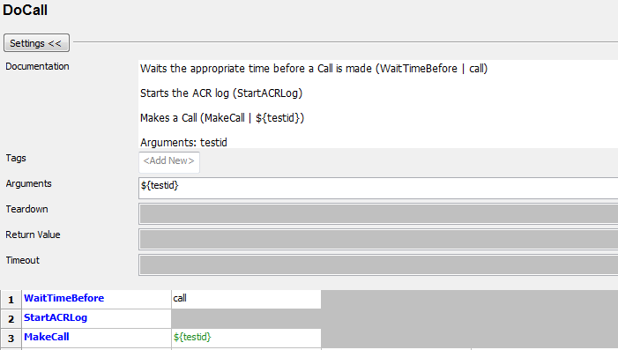
DoCall

Slide 29
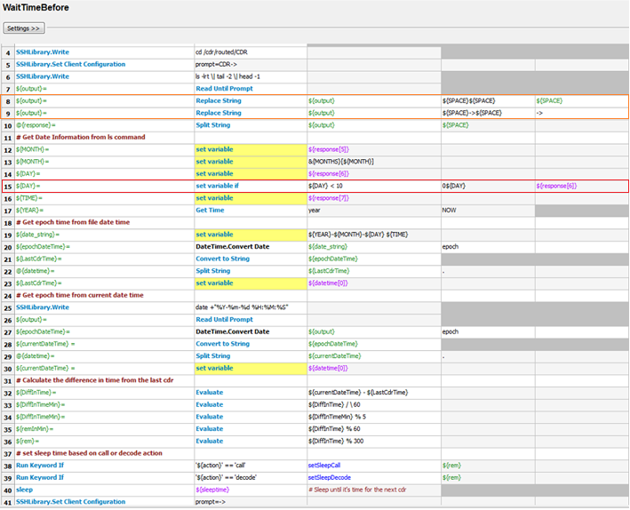
WaitTimeBefore

Slide 30
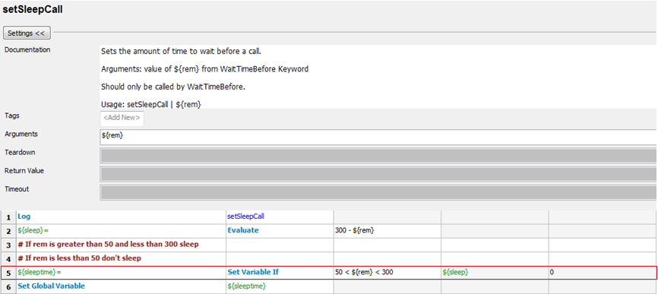
setSleepCall

Slide 31
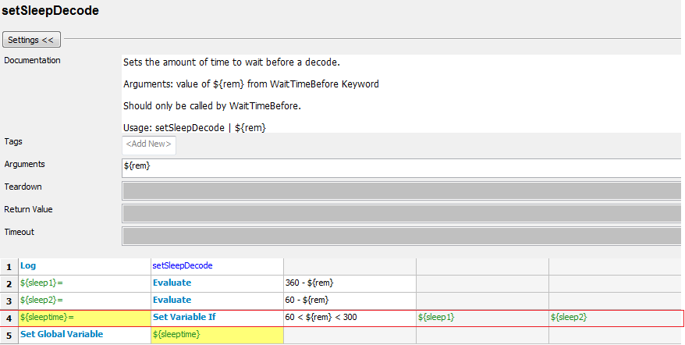
setSleepDecode

Slide 32
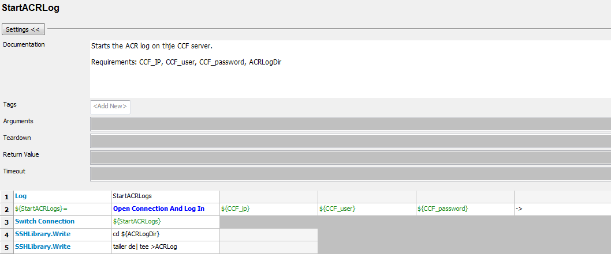
StartACRLog

Slide 33
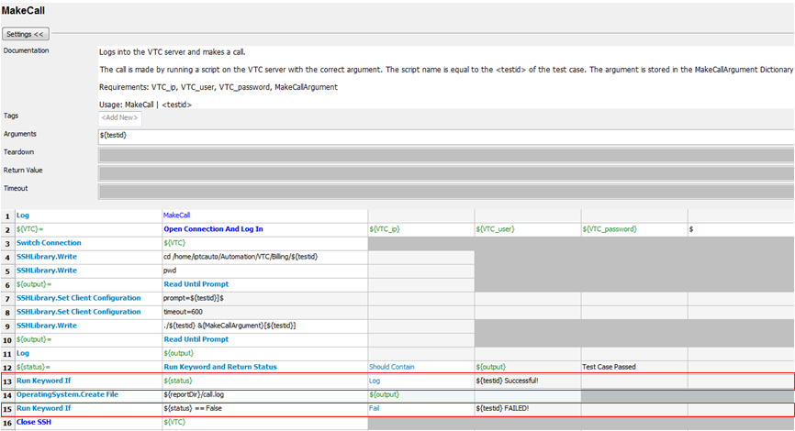
MakeCall

Slide 34
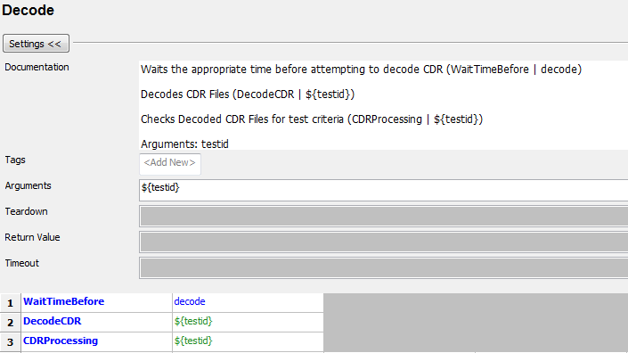
Decode

Slide 35
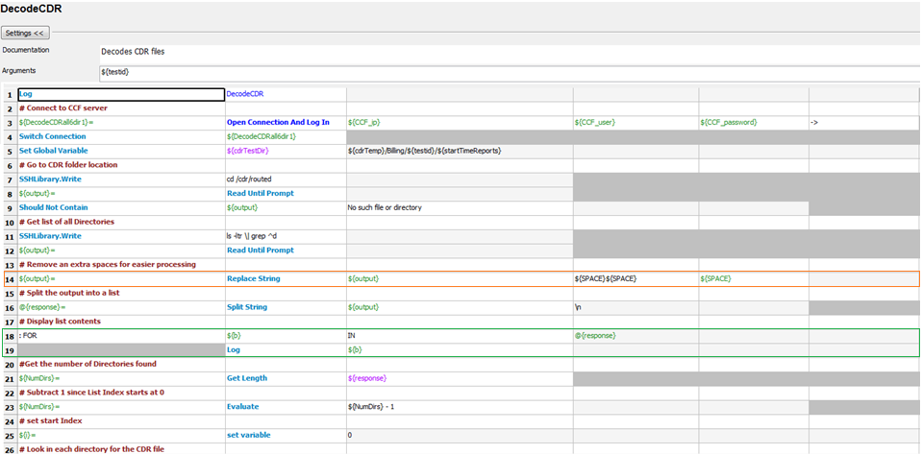
DecodeCDR

Slide 36
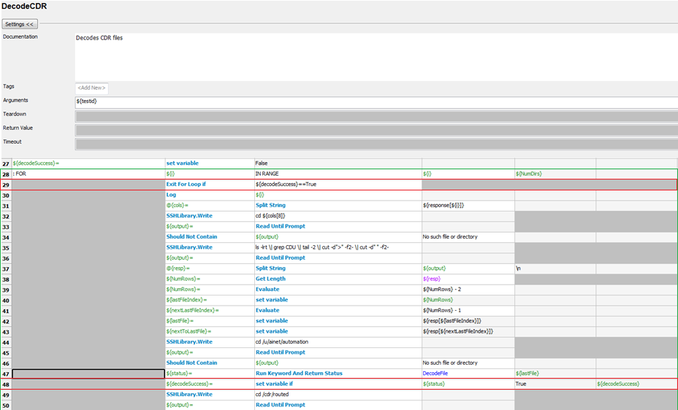
DecodeCDR Continued…

Slide 37
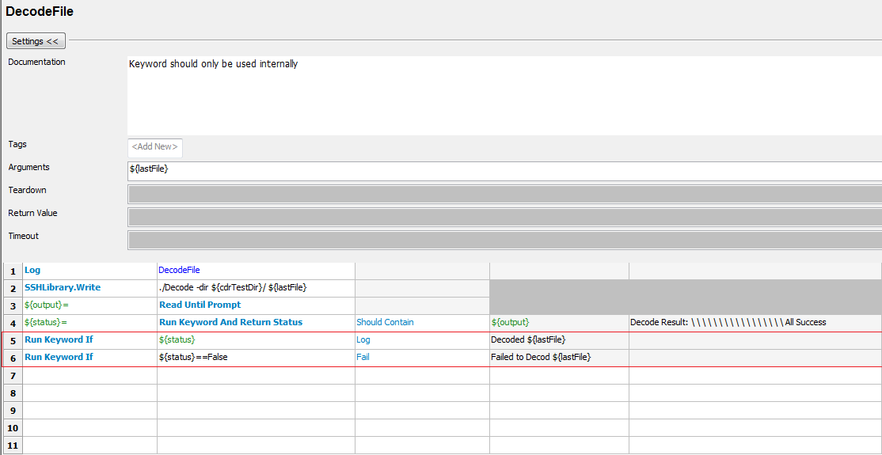
DecodeFile

Slide 38
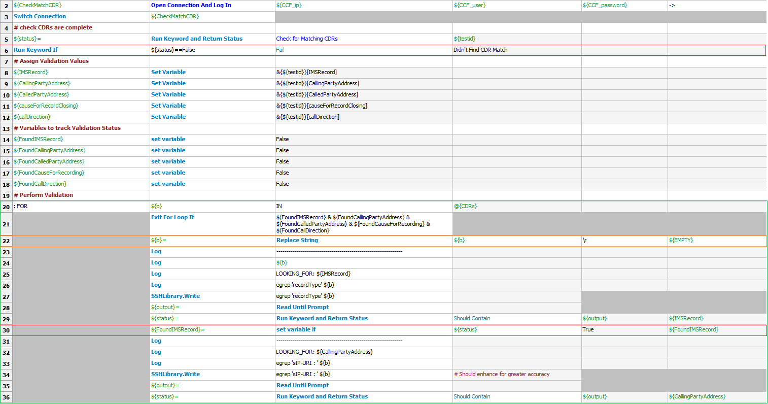
CDRProcessing

Slide 39
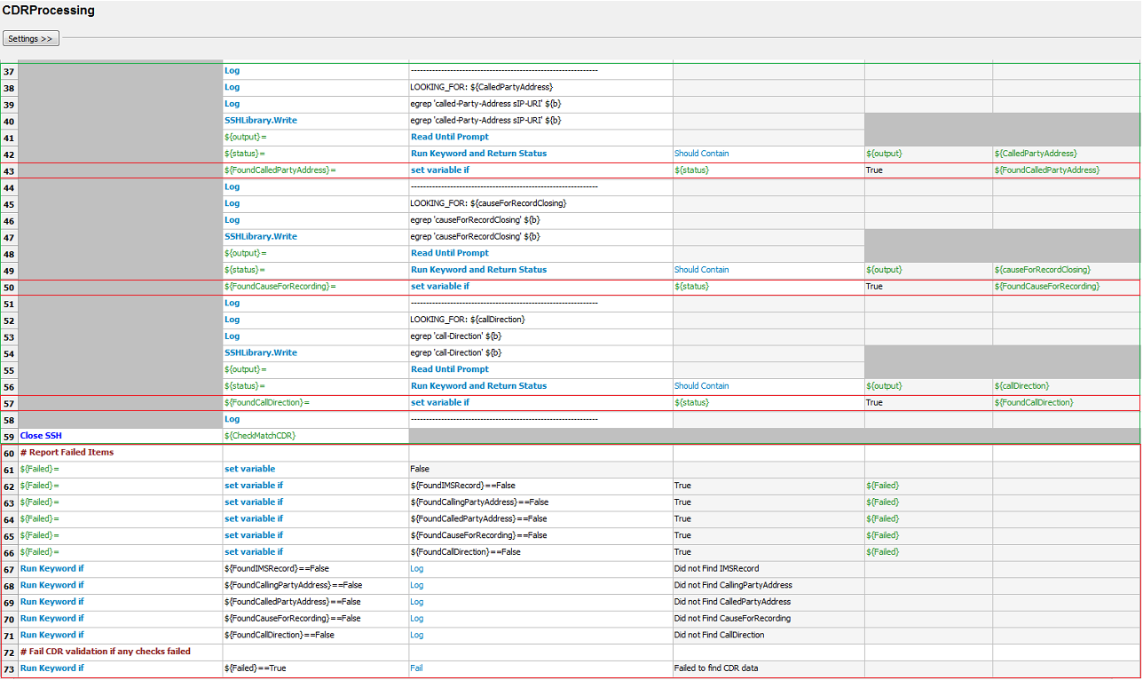
CDRProcessing Continued…

Slide 40
Validation Input File
File Location: ./validation
File Name: G8-CCF-7.txt (${testid})
File Structure: 1 line with , delimiter
File Content: IMSRecord :aSRecord,Calling-Party-Address :sip:+15613330020@ims.net,Called-Party-Address sIP-URI :sip:+19085822787@ims.net,causeForRecordClosing :serviceDeliveryEndSuccessfully,call-Direction :origination

Slide 41
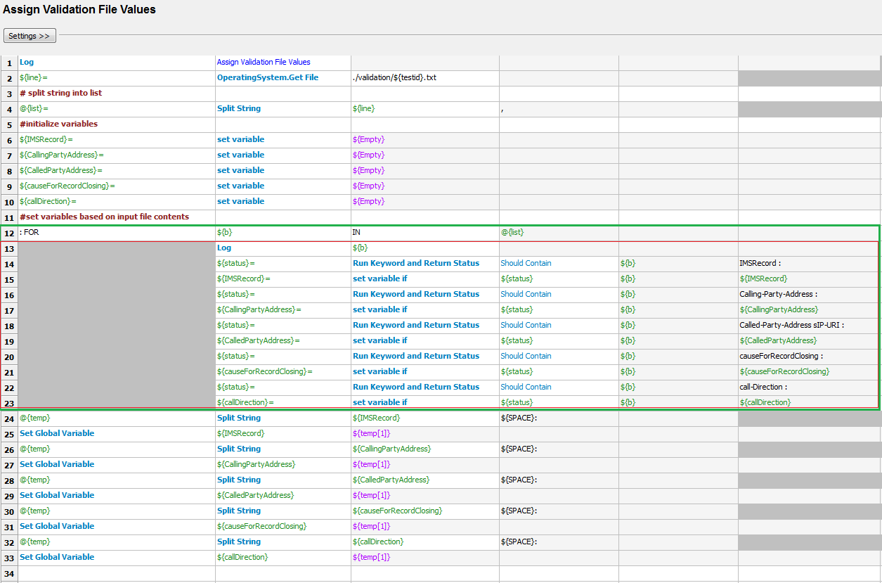
Assigning Variables using Input File

Slide 42
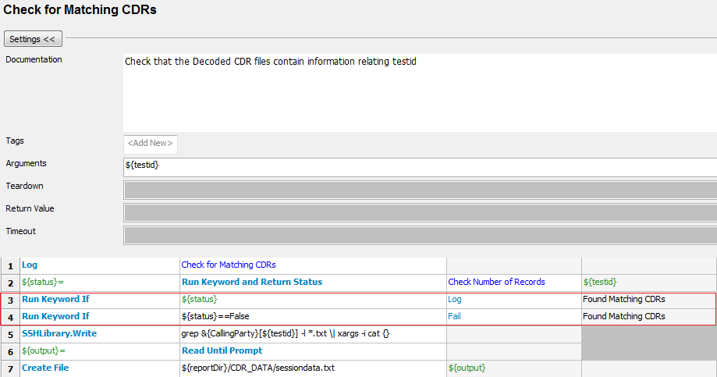
Check For Matching CDRs

Slide 43
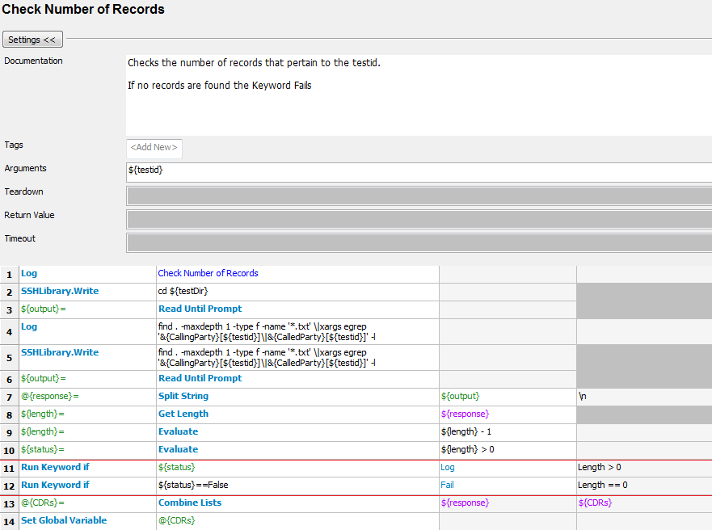
Check Number of Records

